Slide 1







Enterprise Blockchain Developers (Intermediate)
In support of
Powered By

Slide 2
Outline
Introduction to Uniswap App
Overview of Uniswap’s Contracts
Liqudity Pool
Uniswap Fork Process
Uniswap Smart Contracts Deployment
Uniswap Frontend
© 2017-2020 SmartMesh Foundation Pte. Ltd. | MeshBox Foundation Pte. Ltd.

Slide 3
Introduction to Uniswap App
Bond cruving
automatic market making
Pros and Cons
risky for the market maker
need liqudity pool
easy to use for inidvidual traders
movivation for providing liqudity:
1 arbitrage btw uniswap and centralized exchanges
2 “pymid scheme” similar projects adding to liqudity pool and earning money from the later joiner's principle

Slide 4
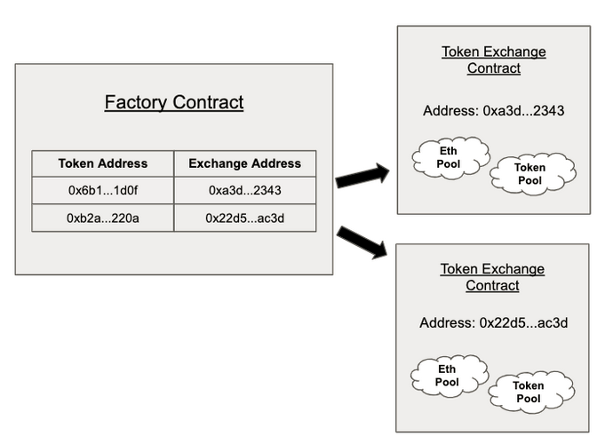
Overview of Uniswap’s Contracts
Exchange contract: Exchange contracts hold a pool of a specific token and Ether that users can swap against.
Factory contract which is in charge of creating new Exchange contracts and registering the ERC20 token address to its Exchange contract address.

Slide 5
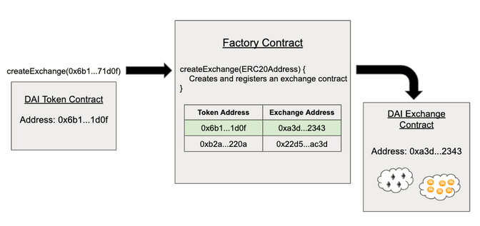
Overview of Uniswap’s Contracts

Slide 6
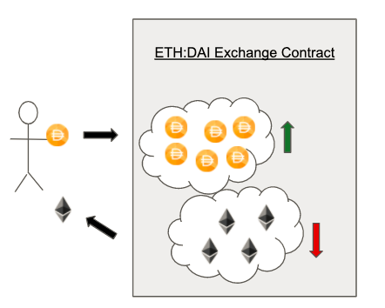
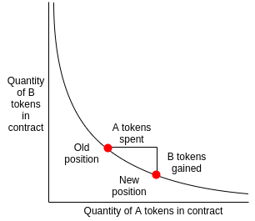
Liqudity Pool

Slide 7
Uniswap Fork Process
1 copy paste the original code
2 customize the code
3 deploy smart contracts + the frontend
https://github.com/Uniswap/uniswap-v2-core
https://github.com/Uniswap/uniswap-v2-periphery
https://github.com/Uniswap/uniswap-interface

Slide 8
Uniswap Smart Contracts Deployment
https://github.com/Uniswap/uniswap-v2-core
Factory = market, creating pairs, setting fees
install nodejs and truffle
npm install -g truffle
mkdir core
cd core
truffle init
cp -r ../uniswap-v2-core/contracts/* contracts
tell truffle how to deply the contracts
create your test tokens
npm init -y
npm install @openzeppelin/contracts@2.5.1

Slide 9
Uniswap Smart Contracts Deployment
Writing the migration file
Setting up the deployment address with gas in it in truffle.config
npm install @truffle/hdwallet-provider
obtain your infura rpc access
truffle deploy --network ropsten

Slide 10
Uniswap Smart Contracts Deployment
https://github.com/Uniswap/uniswap-v2-periphery
truffle init
cp -r ../uniswap-v2-periphery-master/contracts/* contracts
npm install @uniswap/lib @uniswap/v2-core
https://etherscan.io/address/0xc02aaa39b223fe8d0a0e5c4f27ead9083c756cc2#code
get wrapped ether

Slide 11
Uniswap Frontend
https://github.com/Uniswap/uniswap-interface
follow its instructions
git clone https://github.com/Uniswap/uniswap-interface.git or Download the copy
yarn
yarn start
why? let's take a look at it package.json file
it acturally iinstalls all the dependencies and runs “react-scripts start”
replace the contract address
https://github.com/Uniswap/uniswap-interface/blob/c5afbedb3e3d500426f8ebe5d06fca993a7bbd22/src/constants/index.ts

